Slide 1
EXERCISE IN PREGNANCY
RISKS & BENEFITS
ANITA SOMANI MD, FACOG
COMPREHENSIVE WOMEN’S CARE

Slide 2
HISTORY OF EXERCISE IN PREGNANCY
Historically, women were told to cut down or avoid exercise in pregnancy.
Past concerns of miscarriage, harm to fetus have not been proven to occur.
Current guidelines recommend a minimum of 30 minutes of exercise on most if not all days of the week.
Multiple benefits to exercising during pregnancy

Slide 3

MYTHS VS FACTS

Slide 4
MYTHS VS FACTS
You should keep your heart rate below 140 during exercise.
ACOG now recommends “Rate of perceived exertion”

Slide 5
MYTHS VS FACTS
It’s not safe to do abdominal work during pregnancy
Pregnancy requires significant core strength so it is ok to do abdominal exercises as long as you are not flat on your back after 20 weeks.

Slide 6
MYTHS VS FACTS
If you were a runner before pregnancy you can continue to run during pregnancy
ACOG and the National Academy of Medicine both agree that you can run up until the moment you go into labor.

Slide 7
MYTHS VS FACTS
Pregnancy can increase your risk of fitness injuries.
Relaxin softens the ligaments and helps separate the hip bones to create more room during delivery. Avoid injury by avoiding deep muscle or joint movements.

Slide 8
MYTHS VS FACTS
Not every exercise is safe in pregnancy
Balance is affected after the 4th month so avoid exercises that require balance or a shift in gravity

Slide 9
MYTHS VS FACTS
If I exercise too much, I will hurt the baby
The baby will take what it needs in terms of nutrients. Keep blood sugar balanced by eating smaller more frequent meals.

Slide 10
MYTHS VS FACTS
I shouldn’t start an exercise program during pregnancy
It is ok to start with 10 minutes/day and gradually increase till you are able to do 30 minutes/day on most days.

Slide 11
MYTHS VS FACTS
If I have any problems like spotting or pain I should give up exercise through out the pregnancy
You should stop what you're doing and contact your doctor to determine if it is something serious or if you can still exercise.

Slide 12
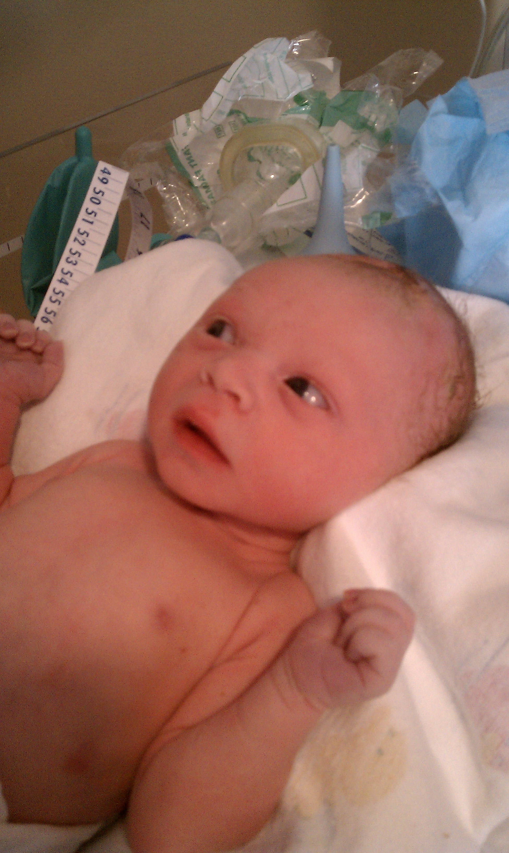
ULTIMATE GOAL!

